Slide 1
CS256 - Milestone 3
Motion / Style Transfer
Group A
Presented By
Ajinkya Rajguru, Branden Lopez, Indranil Patil, Rushikesh Padia, Warada Kulkarni
Prof. Mashhour Solh

Slide 2
Index
Introduction
Motivation
Problem Statement
Literature review
Implementation Details
Dataset
Architecture
Preliminary results
Optimization
Wrapper

Slide 3
Introduction
Evolution in the field of Computer Vision
Convolutional Neural Networks enabling -
Motion Transfer
Image Generation
Style Transfer
Domain Adaptation
Neural network model to synthesize a talking head upon receiving a stream of input frames.

Slide 4

Motivation
https://www.flickr.com/photos/30478819@N08/51093088856

Slide 5
Motivation
Transformation to remote working
CNNs
One less thing to worry about while presenting.
Notes:
User reliance on video conferencing applications due to remote working trends has given rise to new innovative opportunities in these fields.
The progress that has been made so far using the state of the art algorithms has been immense as compared to the classical image processing approaches.
These approaches demonstrate excellent result qualities but can only synthesize fixed viewpoint videos which produce less immersive experiences
A 3D key point representation model proposed in [1] allows for better results for data with coarse-grained features like hair, teeth, and accessories.
Allows for carefreeness when it comes to the facial appearance and environment

Slide 6
Problem Statement
Study of motion transfer models and their feasibility for live video conferencing.

Slide 7
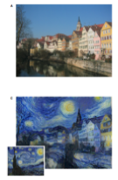
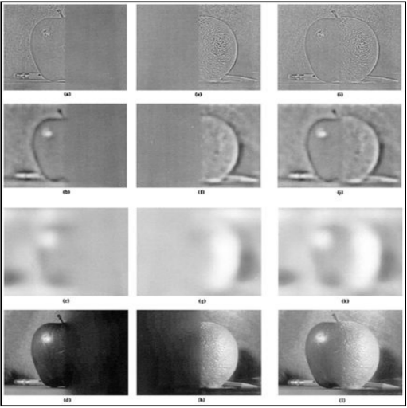
Literature Review
Classical Approach [5]
A multiresolution spline technique.
Set of band-pass filtered images.
Corresponding band-pass mosaic.
CNN [6]
Generation of new images using source style and source content images
Source: P. Burt and E. Adelson, "A multiresolution spline with application to image mosaics," ACM Transactions on Graphics, vol. 2, (4), pp. 217-236, 1983. . DOI: 10.1145/245.247.
Source: L. A. Gatys, A. S. Ecker and M. Bethge, "Image style transfer using convolutional neural networks," in 2016, . DOI: 10.1109/CVPR.2016.265.

Slide 8
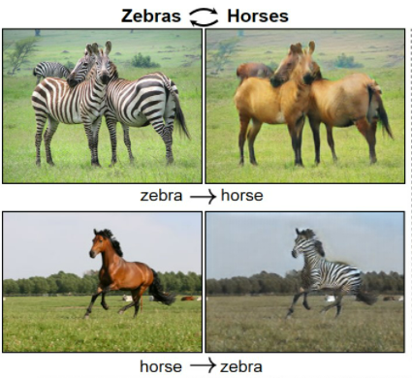
Conditional GANs [7]
Image to Image translation.
Additional input label with source images
Drawback - requires perfect pairs of images from both domains for training
Cycle GANs [9]
Overcomes the drawback of perfect pairing by introducing cycle consistency loss
Translation from one domain to the second one and then back again to first domain
Source: Jun-Yan Zhu et al., 2017

Slide 9
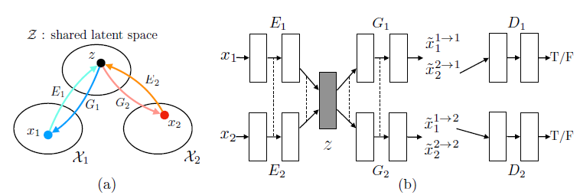
VAE
Aims at learning the joint distribution of images in separate domains by using images from marginal distributions in individual domains
Unstable due to the saddle point searching problem
Style GAN
Learns to separate different aspects of the image
Style modification only affects a certain aspect of the target image
Source: M. Liu, T. Breuel and J. Kautz, "Unsupervised Image-to-Image Translation Networks," 2017.

Slide 10
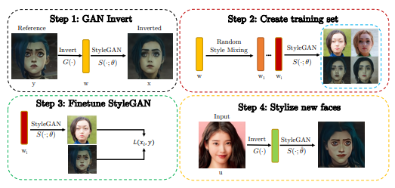
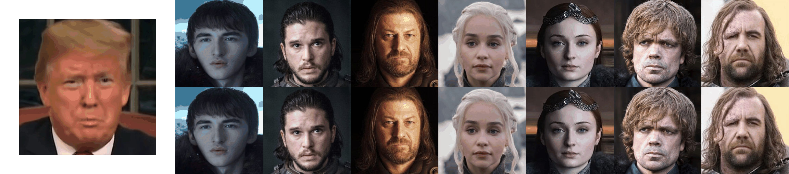
JoJo GAN [14]
Built on StyleGan
GAN inversion to produce a paired data set from a single styling example
Image Animation [16]
Source image is animated based on the motion of a similar object from a video
GAN combines the appearance of image and the motion of video; following a self-supervised strategy inspired by Monkey-Net
[15] Steps of JoJo Gan

Slide 11
Implementation Details
Local machine
Google colab with modified hardware accelerator as GPU.
Local machine with CUDA enabled Nvidia video card.

Slide 12
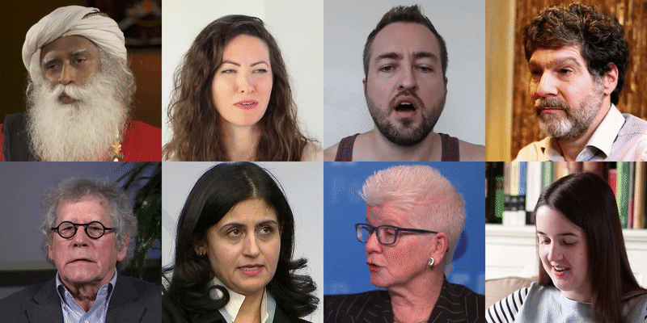
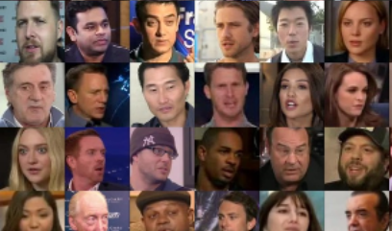
Dataset
VoxCeleb2 : Audiovisual dataset of millions of videos of celebrities extracted from YouTube videos. Videos contain a variety of poses, backgrounds, and lighting conditions.
TalkingHead-1KH : Contains thousands of hours of video recordings of celebrities and people from varied sources with open licenses. Videos are generally of higher quality and resolution than VoxCeleb2.

Slide 13
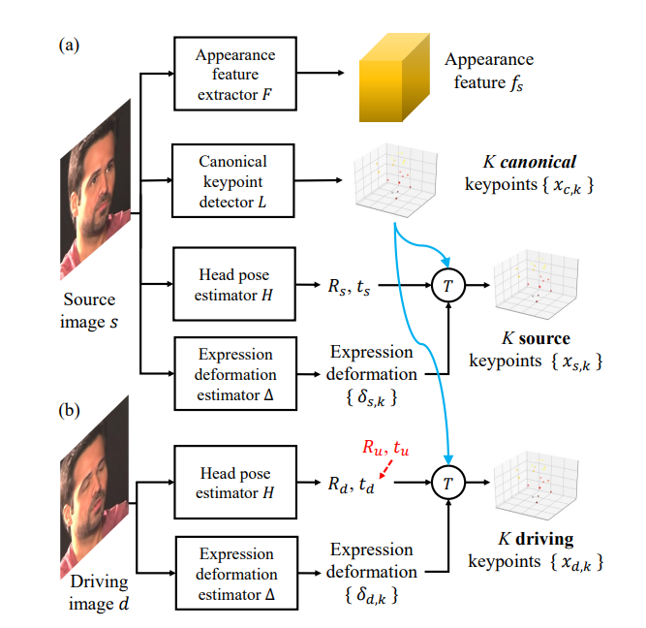
Framework Overview

Slide 14
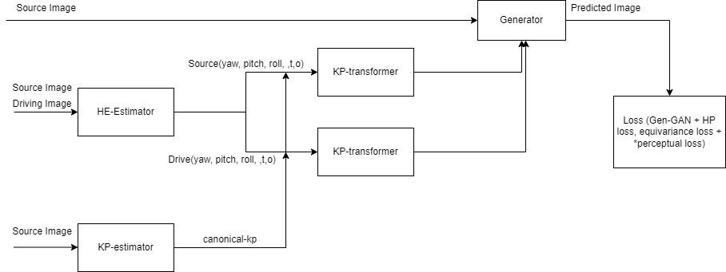
Training Pipeline

Slide 15
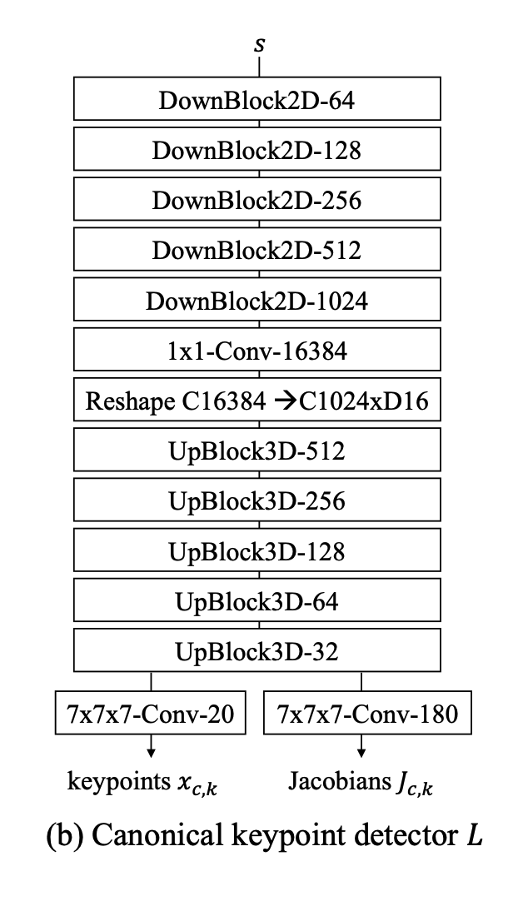
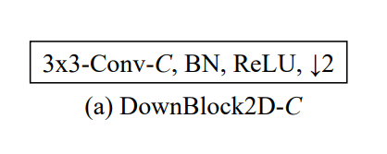
Canonical Keypoint Detector

Slide 16
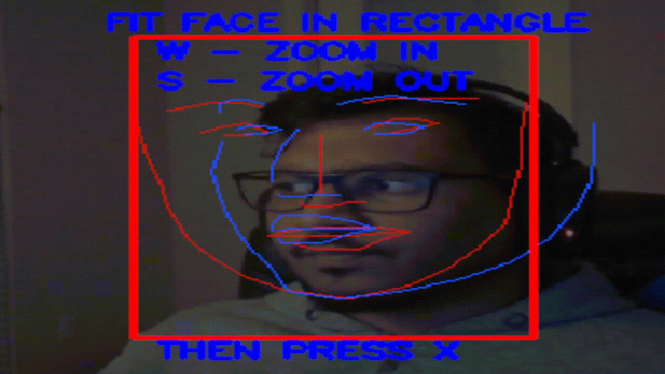
Canonical Keypoint Detector

Slide 17
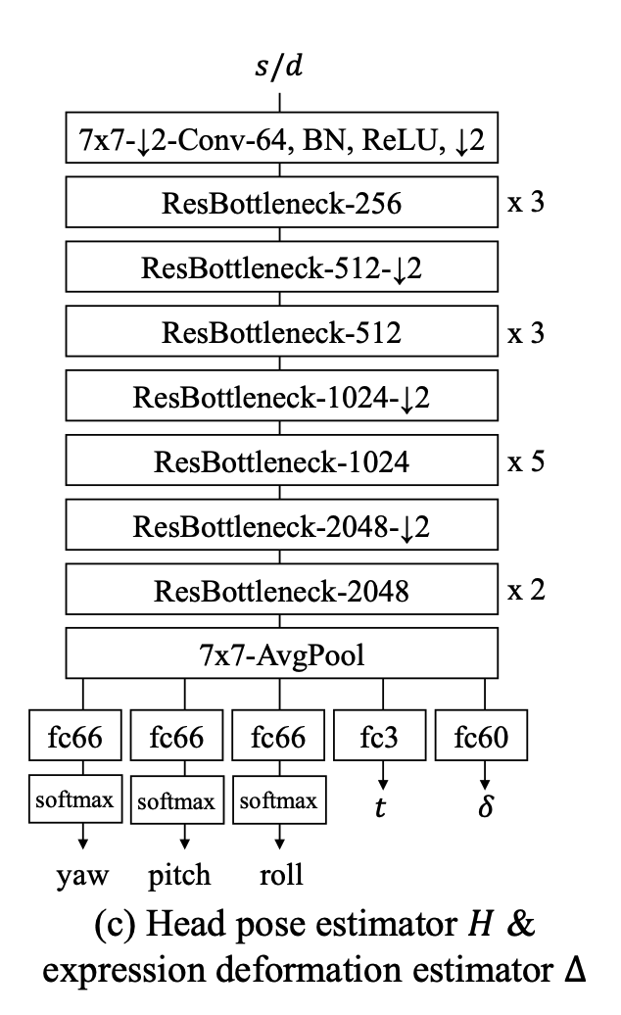
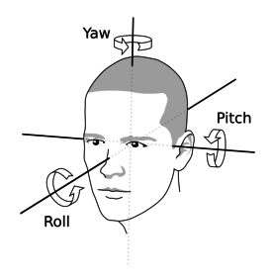
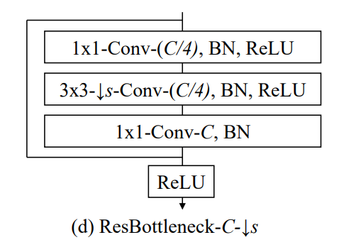
Architecture

Slide 18
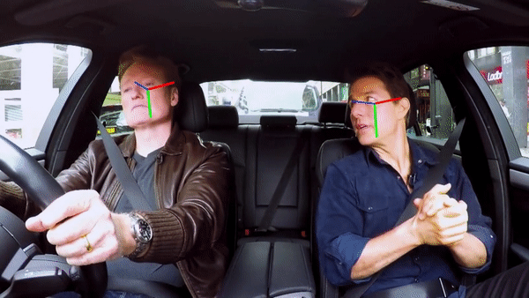
Architecture

Slide 19
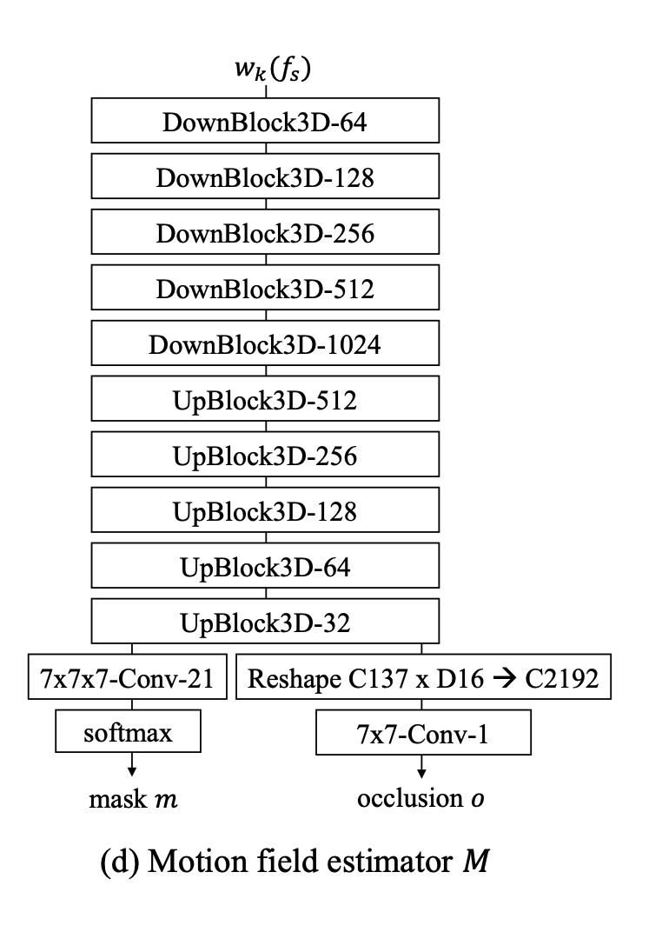
Motion Field Estimator

Slide 20
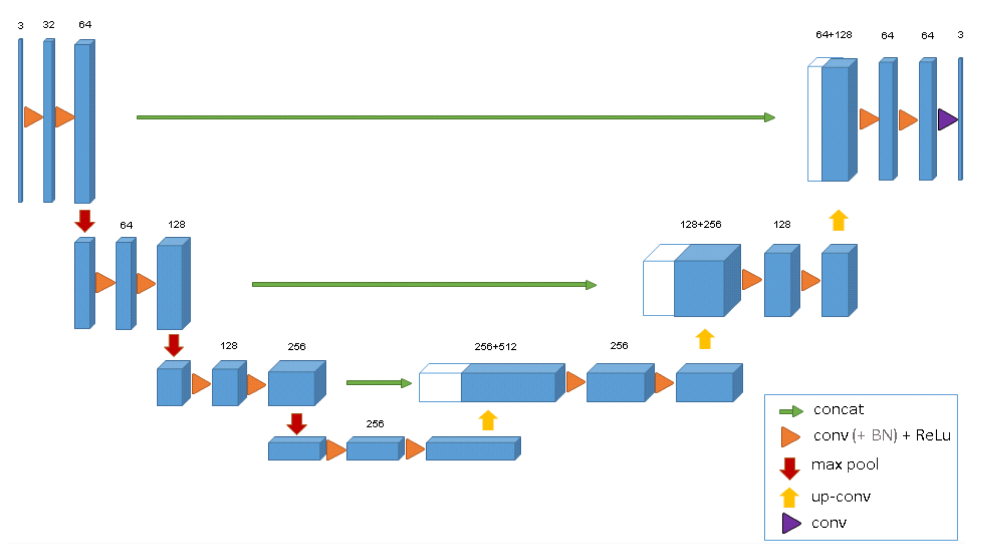
Architecture

Slide 21
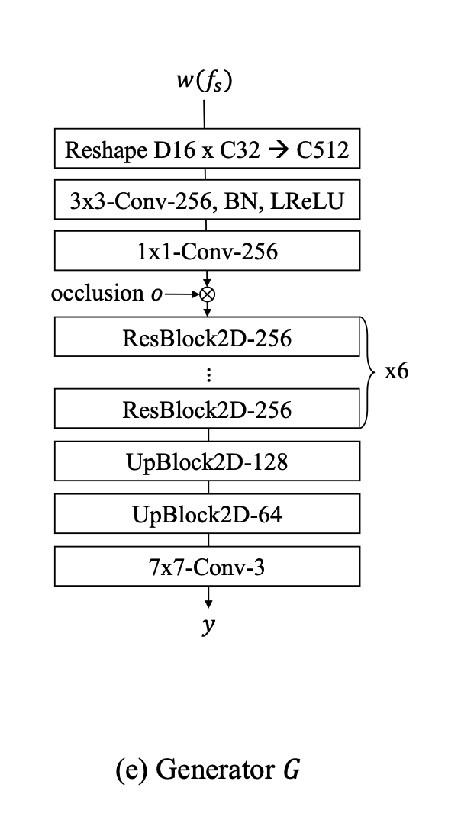
Architecture

Slide 22
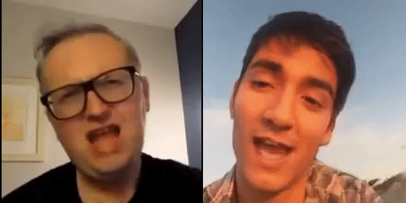
Preliminary Results
The unofficial implementation of One-Shot provided a trained checkpoint.
This is the result.
The checkpoint needs some work. Unfortunately fine tuning for improved results was DOA due to inadequate computational resources.
Inference took 9 seconds per one second of driving video

Slide 23
Optimization
State of the art Deep Learning models are often in the millions, if not tens of millions of parameters.
This often correlates to a long inferences time and large memory requirements, making it difficult to extend models to pragmatic uses.
We explore pruning and quantization in Pytorch to reduce the inference time and memory requirements of One-Shot Head Motion Transfer

Slide 24
Pruning
Aims to create a less parameterized model without sacrificing much accuracy by setting weights to zero.
Many pruning techniques exist but what is important is how a deep learning framework processes it.
After pruning the tensor will be sparse, and this is important because our framework, PyTorch, has limited support for sparse tensors.
Instead it uses dense tensor, a regular tensor that does not process sparsity in an optimal way.
Because of this we will not see any inference/memory improvement with pruning on PyTorch.
Note: As of late 2021 Tensorflow has support for sparse tensors.

Slide 25
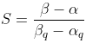
Quantization
In quantization the data type of our parameters is mapped from full 32-bit precision to a lesser precision, often 8-bit Integer precision.
A common mapping function is
Where r is the input, S is our scaling factor, and Z is our zero-point, which ensures that zero from the float gets mapped to zero the integer.
We must calibrate S to find 𝛃 and 𝛂, the clipping range.
By default PyTorch uses min-max method.

Slide 26
Quantization Methods
Dynamic Quantization or Weight-only Quantization: Quantize only the weights before inference, while activation functions are quantized at inference. In PyTorch only Linear and Recurrent Layers are supported for Dynamic Quantization.
Quantization Aware Training: Learns the quantization parameters during training and generally leads to the least accuracy lost. Requires full precision and thus the copious amount of resources used to trained a DNN.
Static Quantization: Both weights and activation functions are quantized before inference. Requires validation data to calibrate.

Slide 27
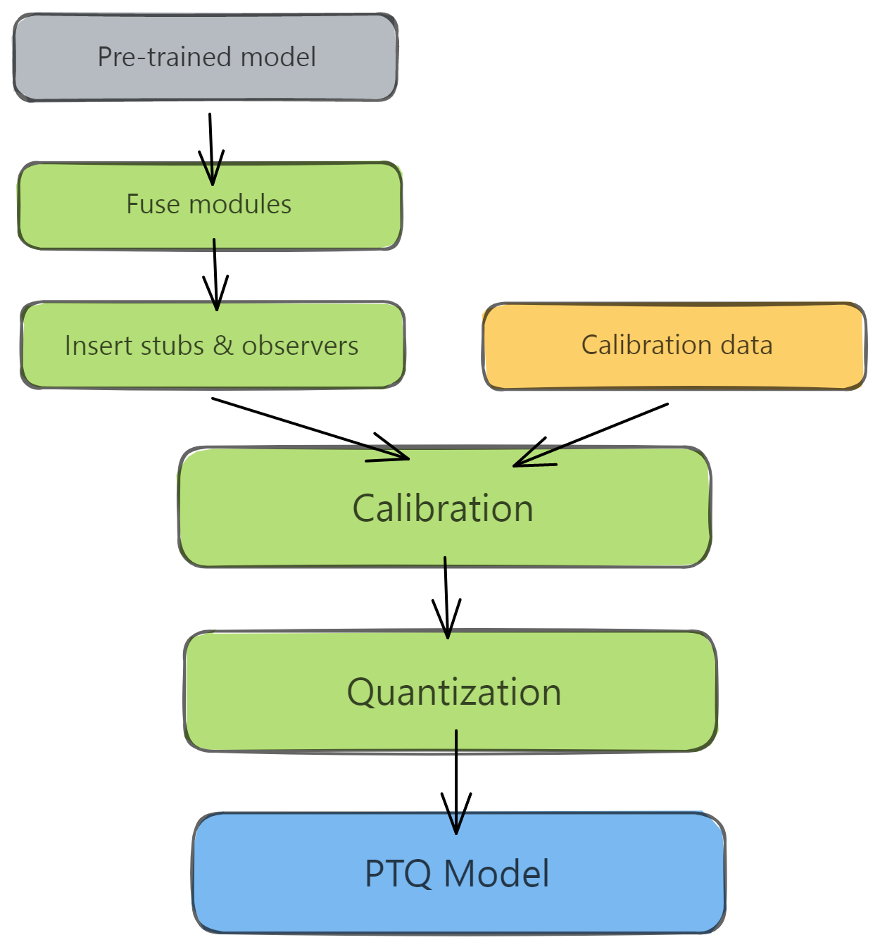
Static Quantization
Static Quantization fuses layers together. IE: Conv2d, Relu
Treating these fused layer as one his speeds things up and improves accuracy by reducing quantization error.
Stubs are what quantize the input/output
Fusing every conv,bn,relu or conv, bn we use.
Calibration Data: 5 second 30 fps video = 150 frames.
We then use the MinMaxObserver as our calibration method.

Slide 28
Static Quantization Results
Memory Size: The size of hopenet was reduced by 3.91 times of the original size, in alignment with the upper theoretical bound of 4 times memory reduction.
Inference time: Averaging inference over 100 samples had a high variance. Producing a model that was .9-1.5 times faster than the other. Far from the ‘typical’ 2-4 times computational speed up. Taking two seconds of inference per second of HopeNet input.
Experimenting with other schemes (Affine, Symmetric, MinMax, etc) might be worth experimenting with as there is no “one-size fits all” solution.
Apply upper theoretical bounds for Pruning and Quantization, inference is too slow to be practical for live video conferencing.

Slide 29
Wrapper

Slide 30
Conclusion
In this project, we explore the feasibility of One-Shot Head Motion Synthesis for real-time video conferencing.
While neural networks could reduce the bandwidth needed for video conferencing by sending information on head movement, generator networks still have much work before they can translate movement into realistic videos in real-time.
Therefore, future exploration should focus on finding efficient architecture for the models without sacrificing generation; then, a generator model can be extended to real-time video conferencing applications.

Slide 31
References
[1] | Wang, T.-C., Mallya, A., & Liu, M.-Y. (2021). “One-Shot Free-View neural talking-head synthesis for video conferencing”. CVPR.
[2] | Joon Son Chung, Arsha Nagrani, and Andrew Zisserman. “VoxCeleb2: deep speaker recognition”. In INTERSPEECH, 2018.
[3] | Martin Heusel, et al, “GANs trained by a two time-scale update rule converge to a local nash equilibrium”. In NeurIPS, 2017 References
[4] | Davis E. King. “Dlib-ml: A machine learning toolkit”. JMLR, 2009
[5] | P. Burt and E. Adelson, "A multiresolution spline with application to image mosaics," ACM Transactions on Graphics, vol. 2, (4), pp. 217-236, 1983. . DOI: 10.1145/245.247.
[6] | L. A. Gatys, A. S. Ecker and M. Bethge, "Image style transfer using convolutional neural networks," in 2016. doi: 10.1109/CVPR.2016.265.
[7] | M. Mirza and S. Osindero, “Conditional generative adversarial nets,” arXiv preprint arXiv:1411.1784, 2014.
[8] | P. Isola, et al, “Image-to-image translation with conditional adversarial networks,” in Proceedings of the IEEE conference on computer vision and pattern recognition, 2017, pp. 1125–1134.
[9] | Langr, J., & Bok, V. (2019). “GANs in Action: deep learning with generative adversarial networks”. Manning. https://books.google.com/books?id=HojvugEACAAJ
[10] | Zhu, J.-Y., et al, “Unpaired image-to-image translation using cycle-consistent adversarial networks”. Computer Vision (ICCV), 2017 IEEE International Conference On.

Slide 32
[11] | R. Xu et al, "face transfer with generative adversarial network," 2017.
[12] | M. Liu, T. Breuel and J. Kautz, "Unsupervised image-to-image translation networks," 2017.
[13] | T. Karras, S. Laine, and T. Aila, “A Style-Based generator architecture for generative adversarial networks,” presented at the - 2019 IEEE/CVF Conference on Computer Vision and Pattern Recognition (CVPR), 2019, pp. 4396–4405, doi: 10.1109/CVPR.2019.00453.
[14] | Chong. Min, and Forsyth. D.A, “JoJoGAN: one shot face stylization”, 2021 doi: arXiv:2112.11641
[15] | Pinkney, J.N., Adler, D.: “Resolution dependent gan interpolation for controllable image synthesis between domains”. arXiv preprint arXiv:2010.05334 (2020).
[16] | Siarohin, Aliaksandr, et al. "First order motion model for image animation." Advances in Neural Information Processing Systems 32, 2019
[17] | T.-C. Wang, A. Mallya, and M.-Y. Liu, “One-Shot Free-View neural talking-head synthesis for video conferencing,” presented at the - 2021 IEEE/CVF Conference on Computer Vision and Pattern Recognition (CVPR), 2021, pp. 10034–10044, doi: 10.1109/CVPR46437.2021.00991.
[18] | Mo S, Cho M, Shin J. Freeze the discriminator: a simple baseline for fine-tuning gans. arXiv preprint arXiv:2002.10964. 2020 Feb 25. https://arxiv.org/pdf/2002.10964.pdf Code: https://github.com/sangwoomo/FreezeD
[19] | Bilogur. Aleksey, “A developer-friendly guide to model pruning in PyTorch”, spell.ml, A developer-friendly guide to model pruning in PyTorch (spell.ml) (accessed May 2022)
[20] | Nair. Dinesh, Solh. Mashhour, Class Lecture, “Computer Vision and Machine Learning at The Edge”, CS-256, San Jose State University, San Jose, SJSU, April 2022.

Slide 33
[21] | S. Subramanian, “Practical Quantization in PyTorch”, pytorch.org, https://pytorch.org/blog/quantization-in-practice (accessed May 11 2022)

